Slide 1
Intro to Robotics
Property of TinkerCORE

Slide 2
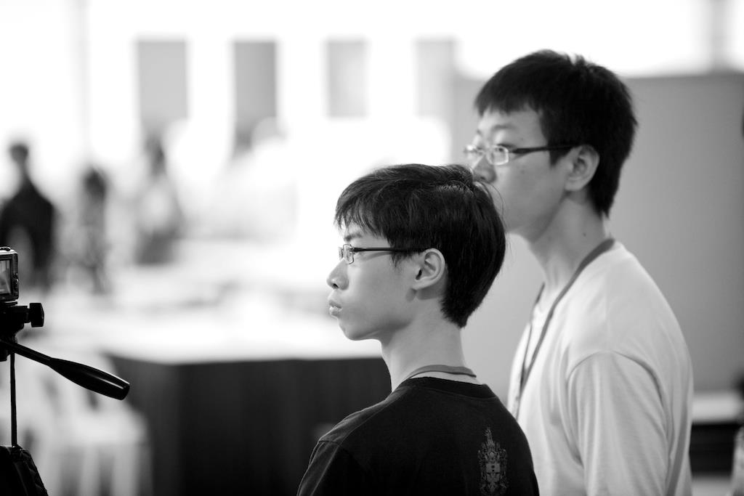
Who we are
Kenneth and Shen Chen
RI Y1-6 (2009 – 2014)
Reinvigorated RIICC in 2009
Kenneth: Robotics Chair
Shen Chen: Programs Manager
Reinvigorated Club Automatica in 2013
Kenneth: Club Chair
Shen Chen: Secretary
Founded CORE in 2014 (to 2017)
Sold CORE to Tinkertanker (2017 to present)

Slide 3
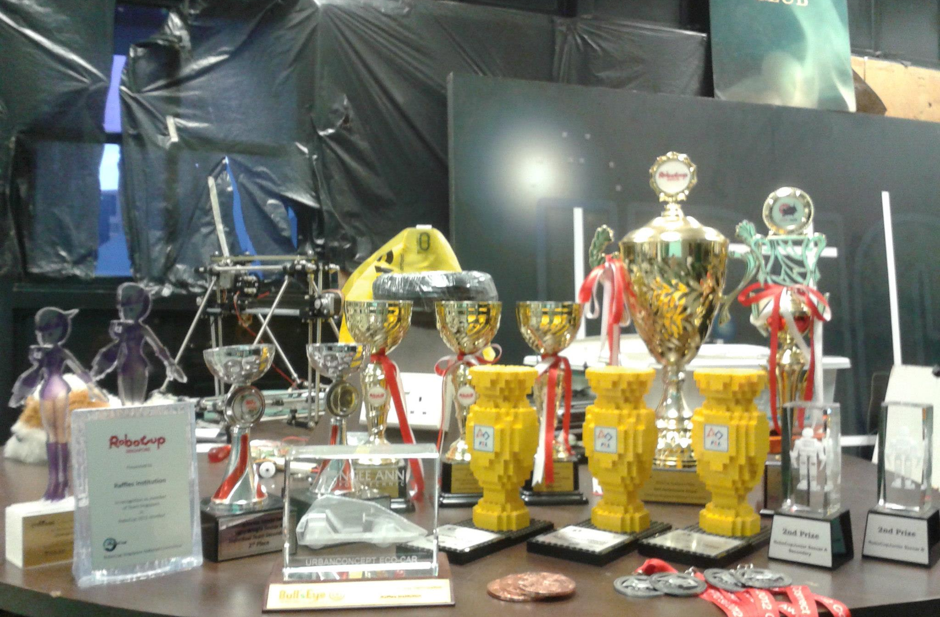
What we’ve done
RIICC (2009 – 2012)
Robocup Nationals: 7 Awards
Robocup Internationals: 2 Awards
FIRST: 4 Awards
NJRC: 1 Award
NSC: 2 Awards
StrITwise: 2 Awards
Organised IPIC
RE Congress Gold for robotics project
Probably some others we don’t remember

Slide 4
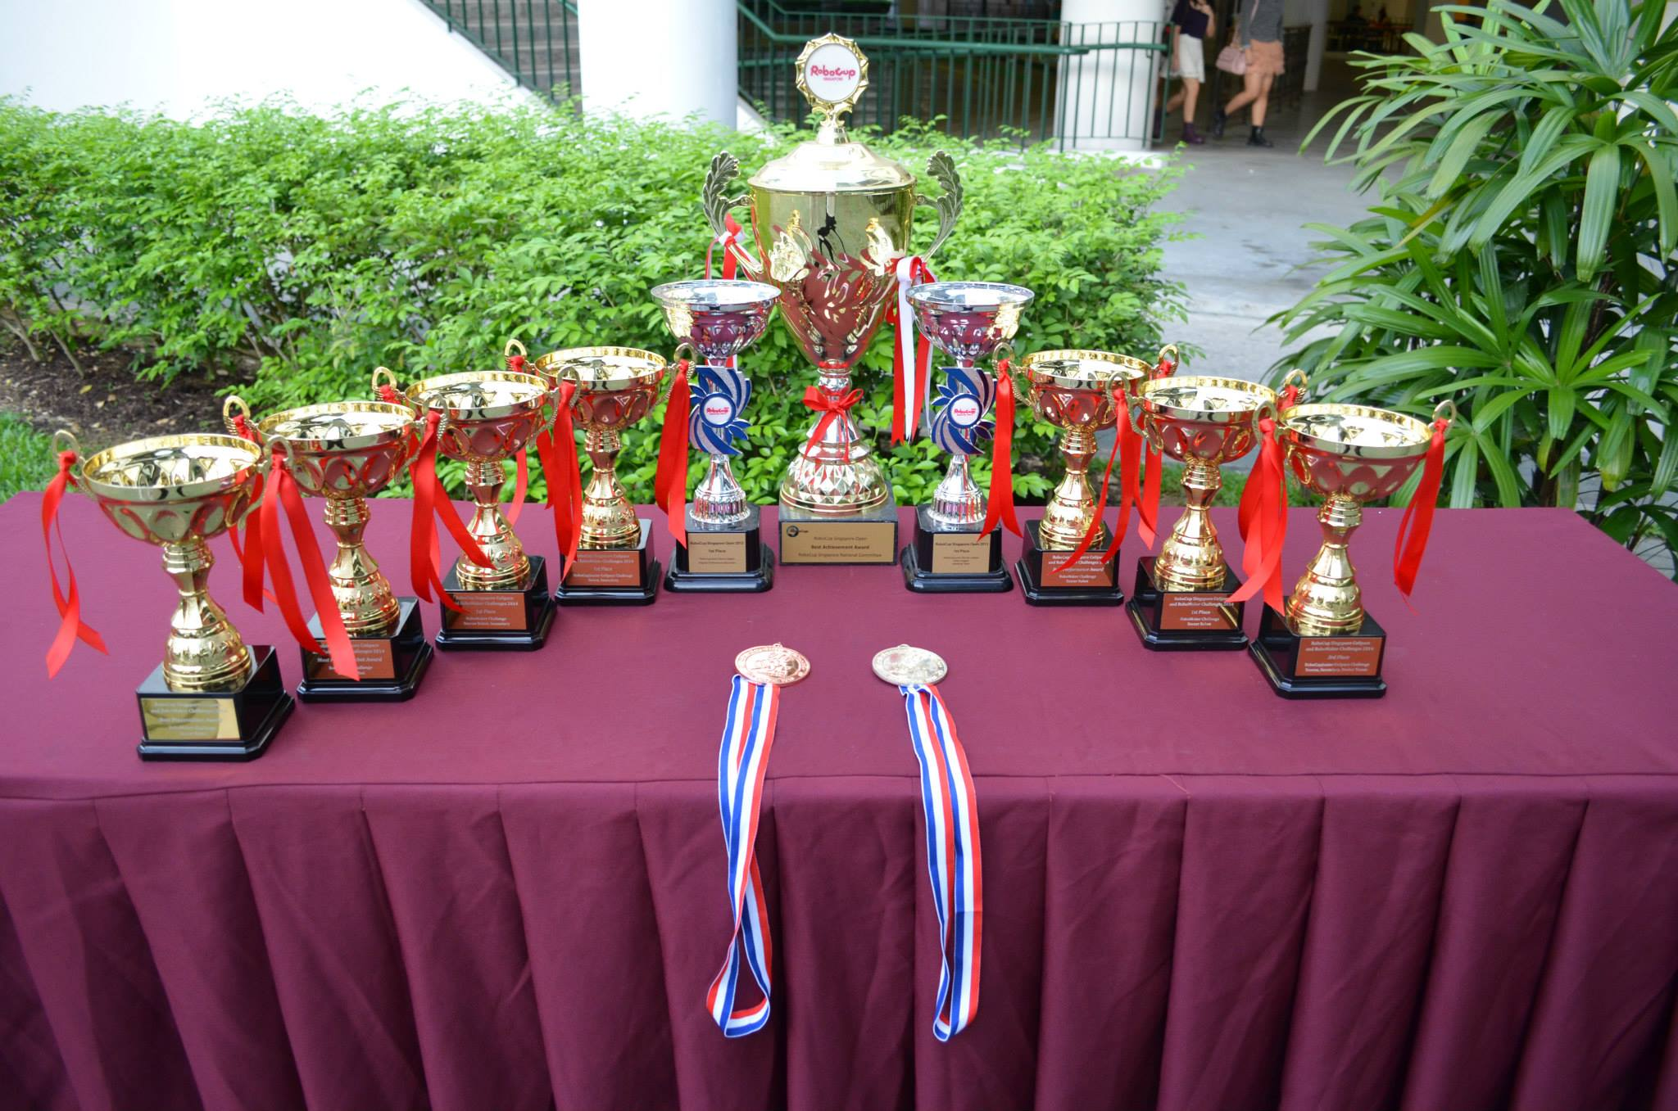
What we’ve done
Club Automatica (2013 - 2014)
Robomaker: 7 Awards
Robocup: 3 Awards
NJRC: 2 Awards
Presented at Singapore Mini Maker Faire
Organised Eureka (robotics component)
Built Club Automatica brand from nothing
INVENT Program (2014)
SiTF Awards Gold/Best Speaker

Slide 5
Stuff we did as coach (2015-2017)
- NJRC Tertiary Champions 2015 - NJRC Best Programming Award 1st 2015 - NJRC Best Research Award 1st 2015 - NJRC Best Presentation Award 2nd 2015 - NJRC Best Journal Award 2nd 2015 - Represented Singapore at WRO Qatar 2015 - Robocup Junior (RCJ) Soccer Singapore Open Open Category 1st 2016 - RCJ Soccer Singapore Open Open Category 2nd 2016 - RCJ Rescue Line Singapore Open 1st 2016 - Represented Singapore at Robocup Leipzig 2016 - RCJ Soccer Leipzig Open Category 10th 2016 - RCJ Rescue Line Leipzig Superteam 3rd 2016 - RCJ Dance Singapore Open Individual 1st 2017 - RCJ Dance Singapore Open Superteam 1st 2017 - National Robotics Competition (NRC, formerly NJRC) 2017 Best Programming Award 2nd 2017 - NRC 2017 Robot Arm Challenge 1st 2017

Slide 6
What is robotics
A brief introduction

Slide 7
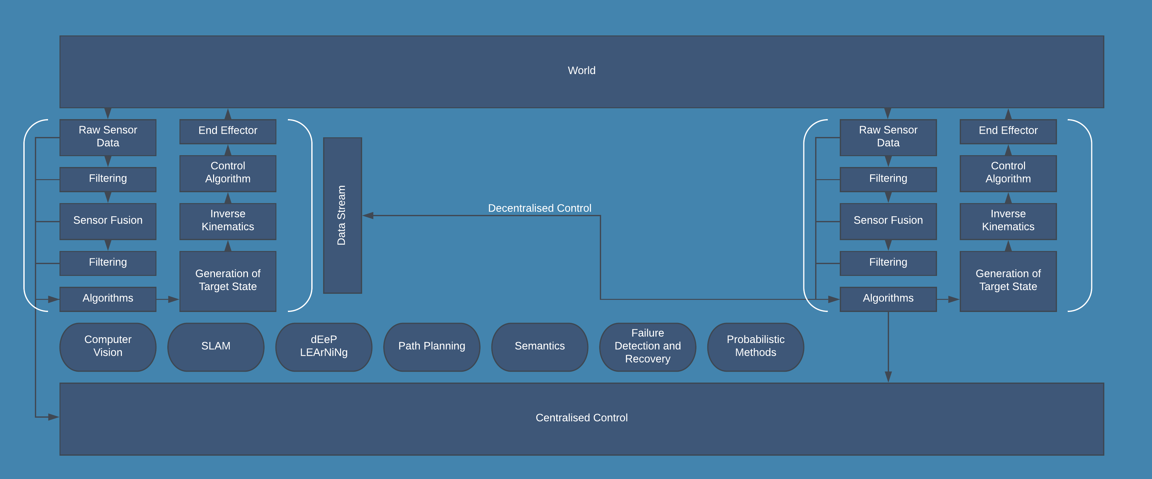
Ground
Air
Sea
Underwater
Surface
Space
Biological

Slide 8
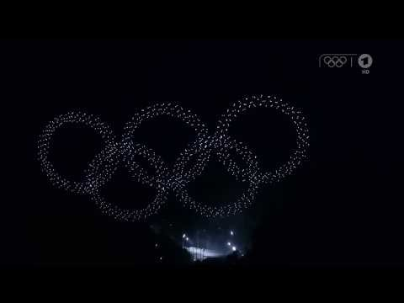

Slide 9
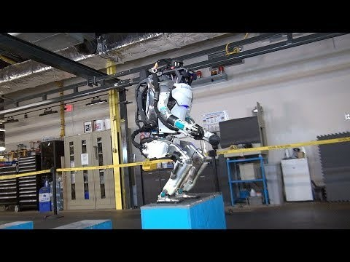

Slide 10
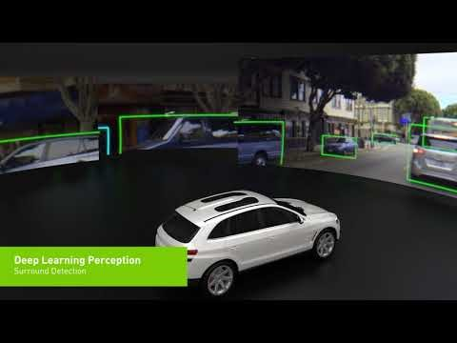

Slide 11
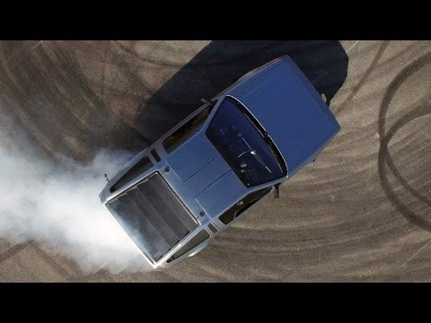

Slide 12
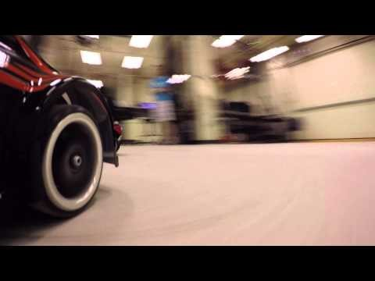

Slide 13
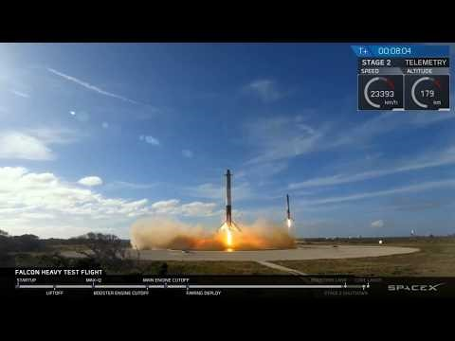

Slide 14
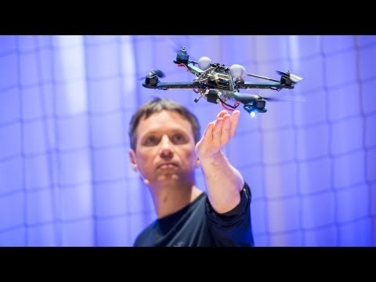

Slide 15
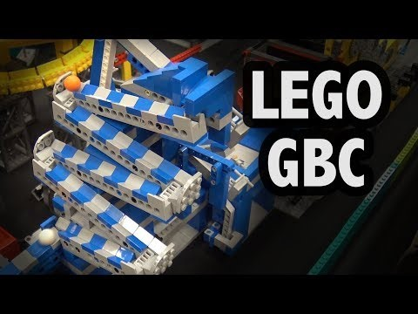

Slide 16
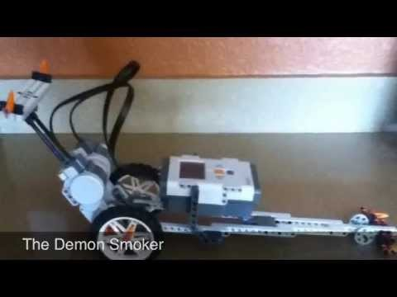

Slide 17
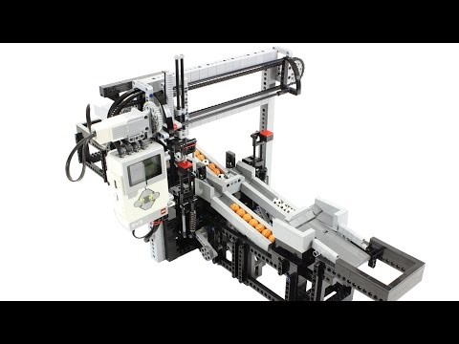

Slide 18
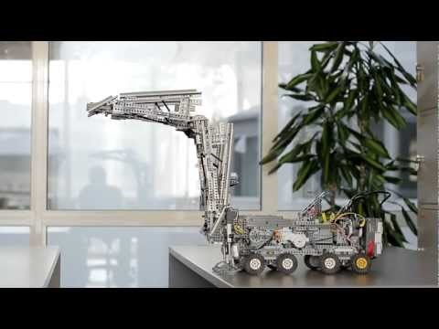

Slide 19
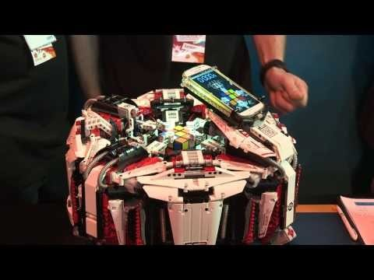

Slide 20
Competitive robotics
A brief introduction

Slide 21
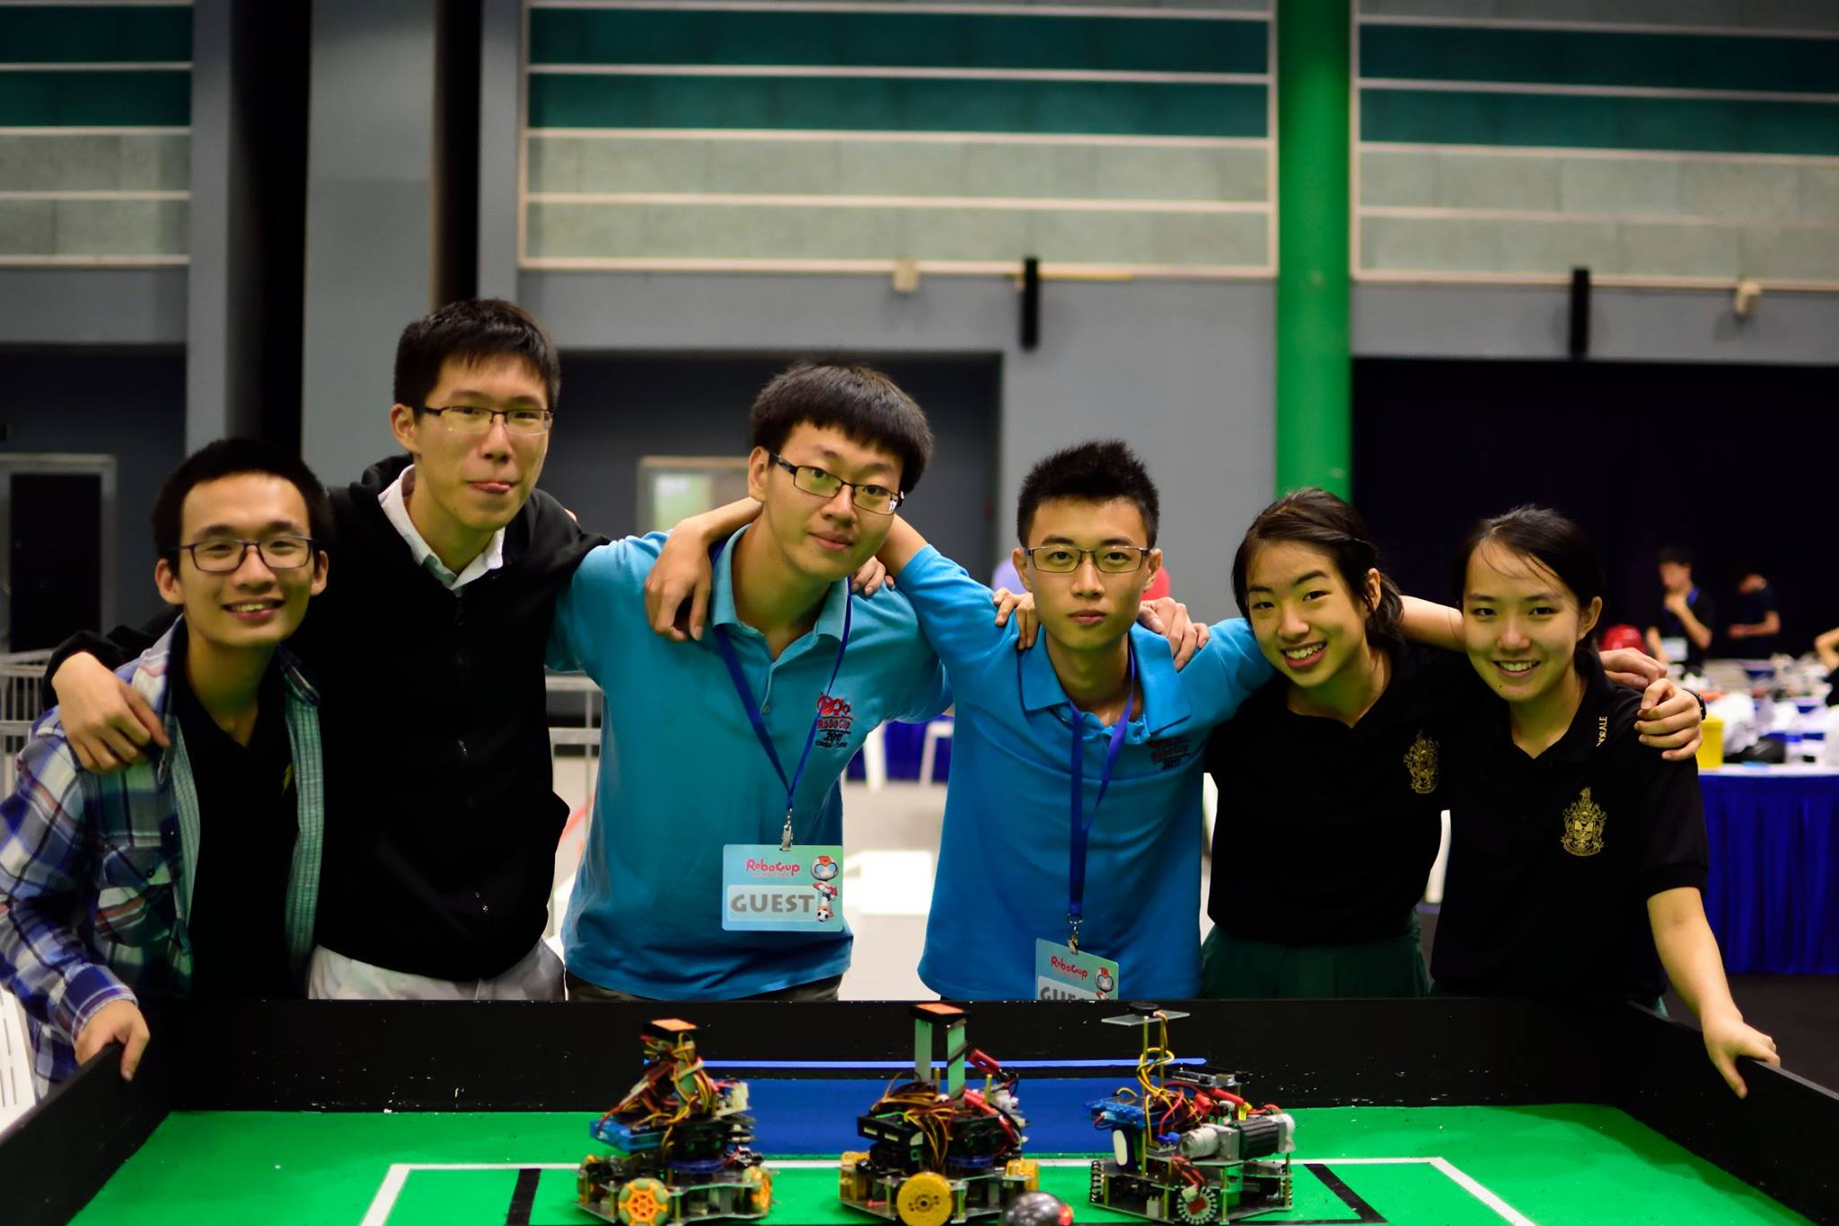
Introduction to Robocup
Usually held in the first week of April
Only World-Class robotics competition available for Secondary level
Sponsored by Siemens, Amazon Robotics, FESTO, KUKA etc.
Contested by 300-500 teams from 35-45 countries per year for the last 10 years
Produces field leading research papers across all of Robotics
Dominated by Raffles locally since its inception

Slide 22
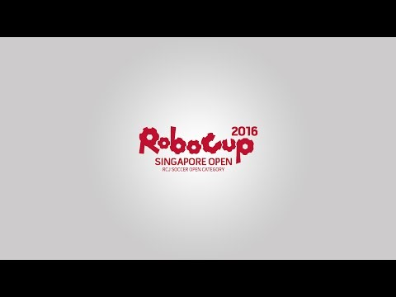

Slide 23
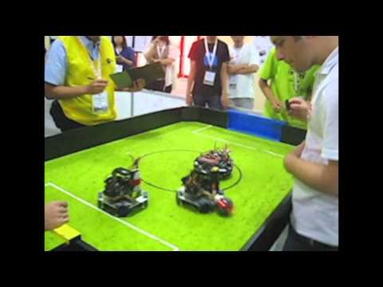

Slide 24
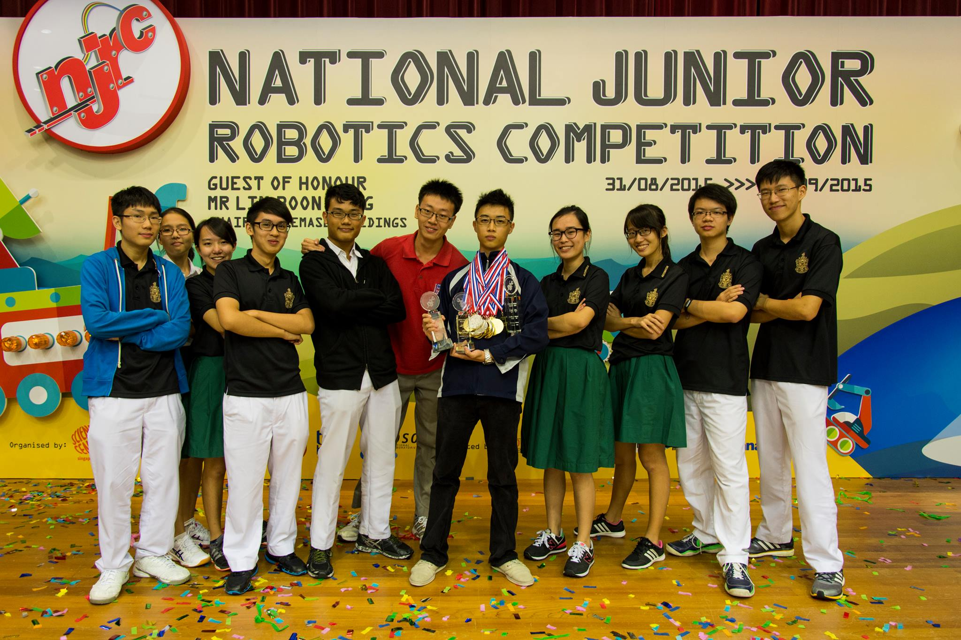
Introduction to NJRC
Held during September Holidays
Largest Robotics Competition in Singapore
Based on LEGO
Low barrier to entry
Able to scale to advanced solutions
Raffles has had sporadic success over the years due to the need for a very compact, efficient workflow through experience/familiarity built over years- a luxury we have not been afforded

Slide 25
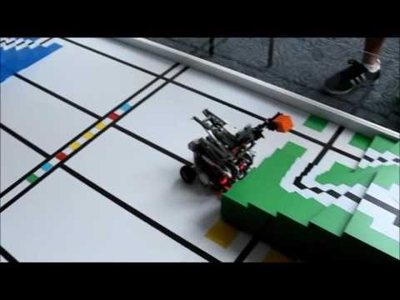

Slide 26
5 Weeks to NRC 2018
Figure out what’s going on:
Official information at nrc.sg
Solutions from other teams on Youtube (search for WRO Junior High 2018)
Form teams of 3 members
Kenneth available for consult anytime on Whatsapp (98283212), Wednesdays (330-630 @ Y5-6), Saturdays (timing TBD @ Y5-6), others dates as available
Work at own time as well
Aim:
Experience competitive robotics
Learn basic robotics/LEGO

